Slide 1

Mileage-Based Transit Fares
Timothy Sweetser, FCAS
Bay Area R Users Group
October 2, 2013

Slide 2
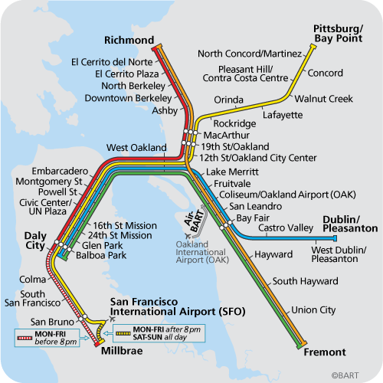
Bay Area Rapid Transit (BART)
Opened in 1972
Serves counties of San Francisco, Alameda, Contra Costa, and Northern part of San Mateo
Does NOT serve counties of Santa Clara, Marin, or the rest of San Mateo
you are here
Notes:
My commute is Rockridge – Pleasant Hill/Contra Costa Centre

Slide 3
Bay Area Rapid Transit (BART)
“BART fares are set with a mileage-based formula, therefore time-based passes (e.g., weekly or monthly) are not available.”
http://bart.gov/tickets/index.aspx

Slide 4
Bay Area Rapid Transit (BART)
“BART fares are set with a mileage-based formula, therefore time-based passes (e.g., weekly or monthly) are not available.”
http://bart.gov/tickets/index.aspx
Let’s figure out the formula! For every trip, we need
The fare
Miles traveled

Slide 5
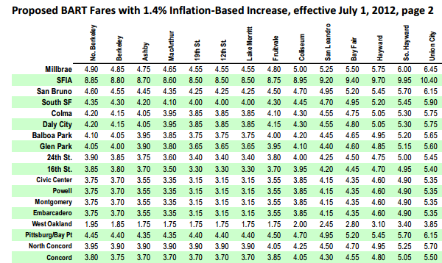
1. BART’s Fare Table
This is an excerpt from http://www.bart.gov/docs/community_meetings/March_2012/1.4_fare%20table.pdf
Notes:
Highlight Millbrae – North Berkeley [1, 1]. $4.90

Slide 6
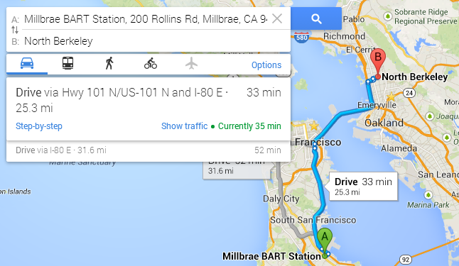
2. Google Maps Driving Directions

Slide 7

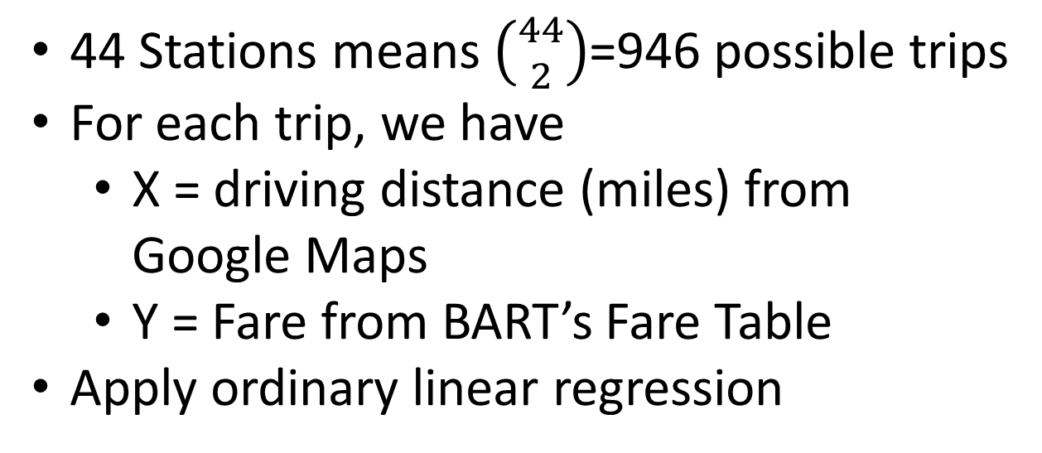
Dataset
44 Stations means $\left({44 \atop 2}\right)$=946 possible trips
For each trip, we have
X = driving distance (miles) from Google Maps
Y = Fare from BART’s Fare Table
Apply ordinary linear regression
$$Fare= β_{0}+β_{1}Miles+β_{2}Airport$$
$$+β_{3}Transbay+ ε$$

Slide 8
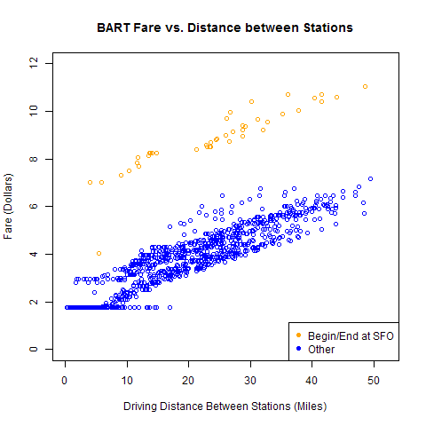

Slide 9
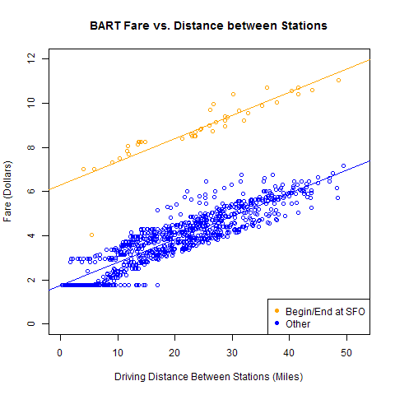

Slide 10
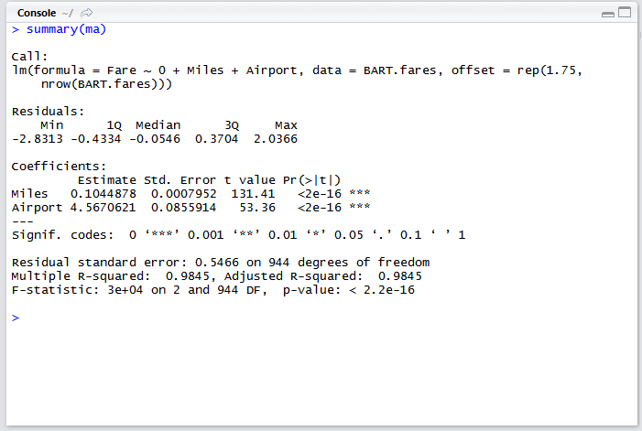
Model Call and Summary

Slide 11
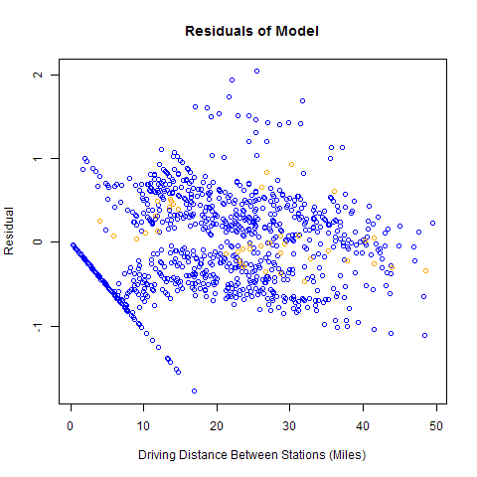

Slide 12
Bay Area Rapid Transit System
Opened in 1972
Serves counties of San Francisco, Alameda, Contra Costa, and Northern part of San Mateo
Does NOT serve counties of Santa Clara, Marin, or the rest of San Mateo
you are here
Notes:
My commute

Slide 13
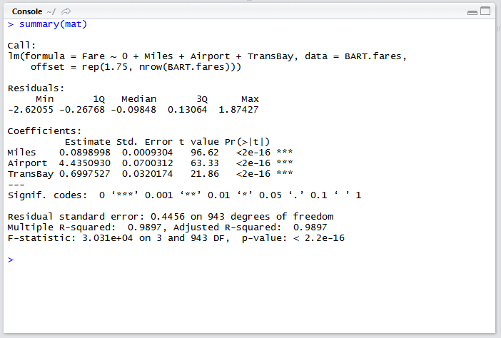
Revised Model
TransBay comes from geocoding each station, and then seeing if the trip begins/ends on different sides of the Bay
Thanks to Statisfaction Blog for the geocode functions
http://statisfaction.wordpress.com/2011/10/05/calling-google-maps-api-from-r/
Notes:
Interact TransBay with Miles

Slide 14
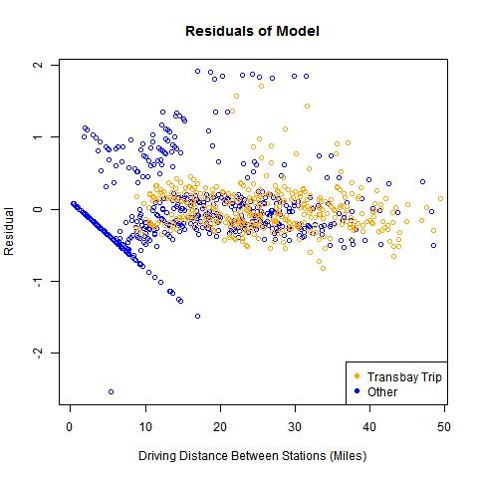

Slide 15
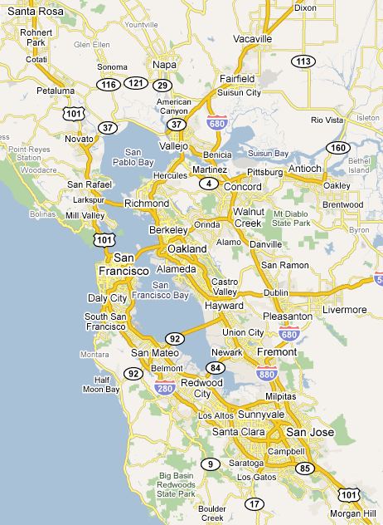
Applications
New Stations
Warm Springs, San Jose, Santa Clara
Pittsburgh, Antioch, Oakley, Brentwood
Livermore
Oakland Airport Connector (2014)

Slide 16
Applications
New Stations
Warm Springs, San Jose, Santa Clara
Pittsburgh, Antioch, Oakley, Brentwood
Livermore
Oakland Airport Connector (2014)
Comparison of marginal costs: 10 cents per mile vs…
Driving
Other transit systems

Slide 17
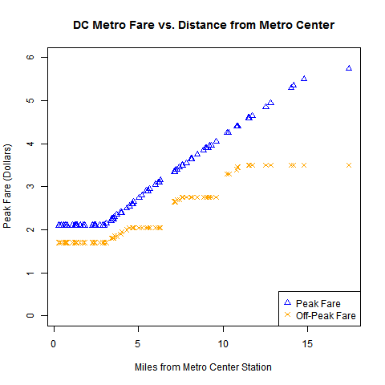
DC Metro System
DC charges higher fares during “peak times”
Miles are provided by Washington Metropolitan Area Transit Authority
Read about it on
https://sites.google.com/site/tsweetser/dc-metro-project

